Slide 1
ROCKS
Geography (1st Sem.)

Slide 2
What is Rock?
Rock or stone is a natural substance, a solid aggregate of one or more minerals or mineraloids. For example, granite, a common rock, is a combination of the minerals quartz, feldspar and biotite. The Earth's outer solid layer, the lithosphere, is made of rock.

Slide 3
What is Minerals?
A mineral is a naturally occurring chemical compound,^{[1]} usually of crystalline form and not produced by life processes. A mineral has one specific chemical composition, whereas a rock can be an aggregate of different minerals or mineraloids. The study of minerals is called mineralogy.

Slide 4
Types of Rocks
1) Igneous Rock
2) Sedimentary Rock
3) Metamorphic Rock

Slide 5
Igneous Rock
Igneous rock (derived from the Latin word ignis meaning fire), or magmatic rock, is one of the three main rock types, the others being sedimentary and metamorphic. Igneous rock is formed through the cooling and solidification of magma or lava. The magma can be derived from partial melts of existing rocks in either a planet's mantle or crust. Typically, the melting is caused by one or more of three processes: an increase in temperature, a decrease in pressure, or a change in composition.

Slide 6
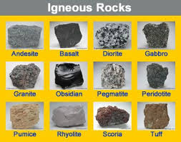

Slide 7
Types of Igneous Rock
1) Extrusive :Extrusive rock refers to the mode of igneous volcanic rock formation in which hot magma from inside the Earth flows out (extrudes) onto the surface as lava or explodes violently into the atmosphere to fall back as pyroclastics or tuff. ... Examples of extrusive rocks include basalt, rhyolite, andesite, obsidian and pumice.
2) Intrusive : Intrusive rock, also called plutonic rock, igneous rock formed from magma forced into older rocks at depths within the Earth's crust, which then slowly solidifies below the Earth's surface, though it may later be exposed by erosion.
Granite,Gabro
A) Plutonic: Intrusive rocks formed at greater depths are called plutonic or abyssal. Granite.
B) Hypabyssal: Some intrusive rocks solidified in fissures as dikes and intrusive sills at shallow depth and are called subvolcanic or hypabyssal. They show structures intermediate between those of extrusive and plutonic rocks. They are very commonly porphyritic

Slide 8
Sedimentary Rock
Sedimentary rocks are types of rock that are formed by the deposition and subsequent cementation of mineral or organic particles on the floor of oceans or other bodies of water at the Earth's surface. Sedimentation is the collective name for processes that cause these particles to settle in place. Sand stone, Shale

Slide 9
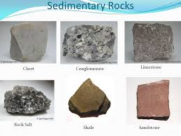

Slide 10
Types of Sedimentary rock
Clastic sedimentary rocks such as breccia, conglomerate, sandstone, siltstone, and shale are formed from mechanical weathering debris.
Chemical sedimentary rocks, such as rock salt, iron ore, chert, flint, some dolomites, and some limestones, form when dissolved materials precipitate from solution.
Organic sedimentary rocks such as coal, some dolomites, and some limestones, form from the accumulation of plant or animal debris.

Slide 11
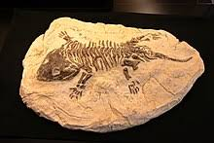
Fossils
A fossil (from Classical Latin fossilis; literally, "obtained by digging")^{[1]} is any preserved remains, impression, or trace of any once-living thing from a past geological age. Examples include bones, shells, exoskeletons, stone imprints of animals or microbes, objects preserved in amber, hair, petrified wood, oil, coal, and DNA remnants. The totality of fossils is known as the fossil record.

Slide 12
Metamorphic Rock
A metamorphic rock is a type of rock which has been changed by extreme heat and pressure. Its name is from 'morph' (meaning form), and 'meta' (meaning change). The original rock gets heated (temperatures greater than 150 to 200 °C) and pressured (1500 bars). This causes profound physical and/or chemical change.
Basalt- Amphibolite
Grinite- Gnise
Lime Stone- Marble

Slide 13
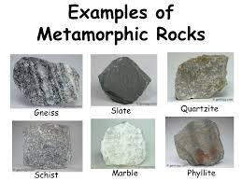
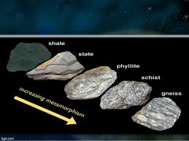

Slide 14
Types of metamorphic rock
Foliated Metamorphic Rocks
Foliated metamorphic rocks are formed from direct exposure to pressure and heat. They are the most vital and largest groupings of metamorphic rocks. Foliated metamorphic rocks have four distinguishable types of aligned textures and they normally have a banded or layered appearance. Examples include slate, gneiss, phyllite, and schist. Non-foliated are formed as a result of tectonic movements or direct pressure which makes their formation highly dependent on their pre-existing conditions.
Non-foliated Metamorphic Rocks
Non-foliated metamorphic rocks do not have a banded or layered appearance. The extensively known example of non-foliated metamorphic rock is marble. Other examples include quartzite, hornfels, and novaculite.

Slide 15
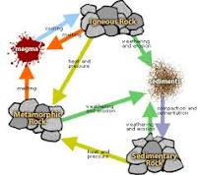
Rock cycle
The Rock Cycle is a group of changes. Igneous rock can change into sedimentary rock or into metamorphic rock. ... Igneous rock forms when magma cools and makes crystals. Magma is a hot liquid made of melted minerals.

Slide 16
THANK YOU

